Slide 1


JavaFX GUI Components (2) • Sep. 27, 2021
JavaFX GUI Components (2) • Sep. 27, 2021
JavaFX GUI Components (2) • Sep. 27, 2021
MANIPULATING JAVAFX GUI COMPONENTS (2)
Amir Amine
Anthony Zaatar
Ralph Kmeid

Slide 2
JavaFX GUI Components (2) • Sep. 27, 2021
Focus Areas
- Table View (javafx.controls)
- List View (javafx.controls)
- Tree View (javafx.controls)
- Date Chooser (javafx.controls)
- Color Chooser (javafx.controls)
- Progress Bar (javafx.controls)
- Pagination Control (javafx.controls)
- File Chooser (javafx.stage)
- HTML Editor (javafx.web)
Presentation Highlights

Slide 3
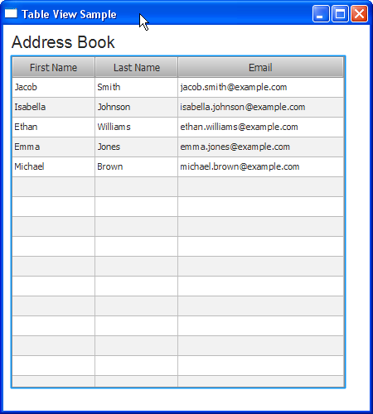
Table View
Implements a data model to be presented in a tabular form.
The table view classes have a range of features such as nested columns, resizing columns and rows, sorting the items alphabetically or numerically, etc...
JavaFX GUI Components (2) • Part 1

Slide 4
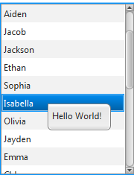
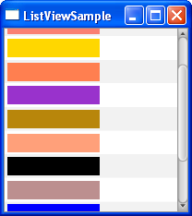
List View
The ListView class represents a scrollable list of items which can represent strings, colors, numbers...
Events can be called whenever an item is selected.
JavaFX GUI Components (2) • Part 1

Slide 5
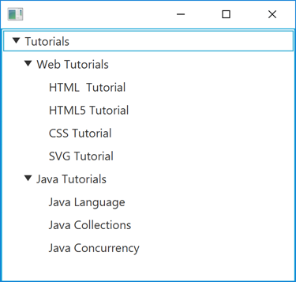
Tree View
A hierarchical view of data in a tree-like format.
It consists of a main root, with nodes as children. Each node can also have children of its own. All of these are called Tree Items which can be expanded and collapsed
A leaf Tree Item has no children.
JavaFX GUI Components (2) • Part 1

Slide 6
JavaFX GUI Components (2) • Part 1
LIST VIEW
Demo
TABLE VIEW
TREE VIEW

Slide 7
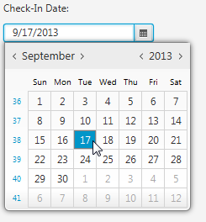
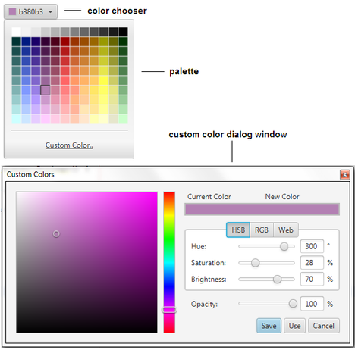
JavaFX GUI Components (2) • Part 2
Date Picker
Color Chooser
Allows users to enter a date or select a date from calendar popup
Enables users to select a color from the available range or set an additional color using an RGB or HSB combination

Slide 8
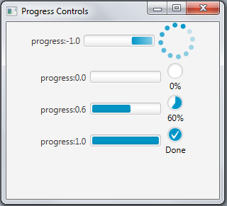
JavaFX GUI Components (2) • Part 2
Track the progress of a certain task
Takes double values between 0 and 1
Progress Bar

Slide 9
JavaFX GUI Components (2) • Part 2
Date Picker
Demo
Color Chooser
Progress Bar

Slide 10
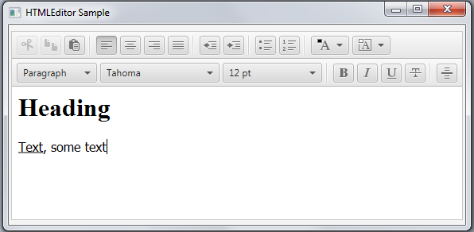
HTML Editor
Rich Text Editor based on the editing features of HTML5
Text Formatting
Layout modification and changing the appearance of a text
JavaFX GUI Components (2) • Part 3

Slide 11
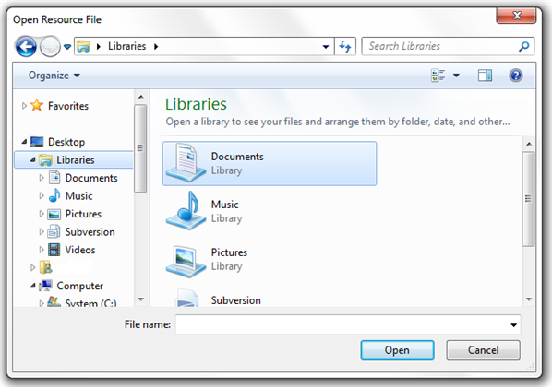
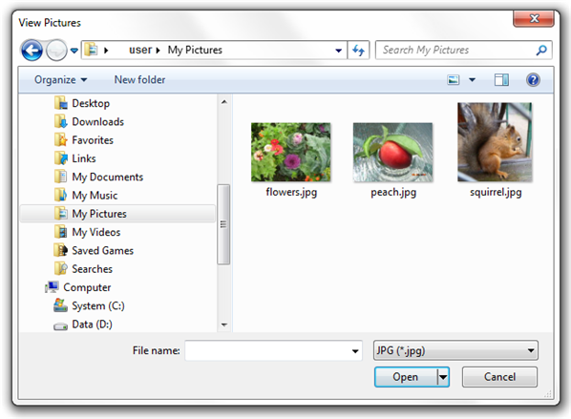
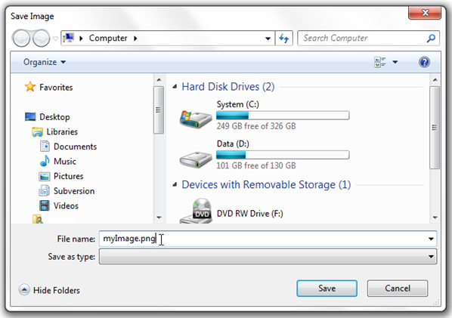
JavaFX GUI Components (2) • Part 3
File Chooser
CHOOSING FROM DIRECTORIES
CHOOSING A FILE TYPE
SAVING IN A DIRECTORY

Slide 12
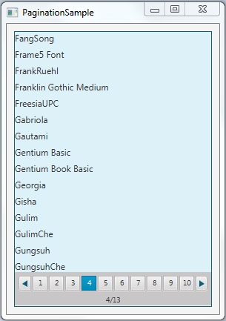
JavaFX GUI Components (2) • Part 3
Pagination Control
Navigate through multiple pages of data
We can choose the maximum number of items per page

Slide 13
JavaFX GUI Components (2) • Part 3
HTML Editor
Demo
File Chooser
Pagination Control

Slide 14

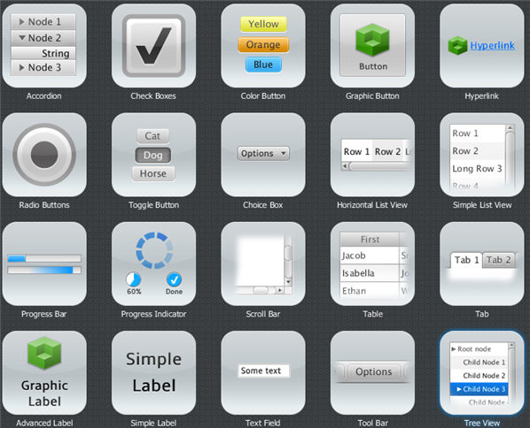
JavaFX GUI Components (2) • Sep. 27, 2021
CONCLUSION
Data Manipulation:
-View Data
-Add Data
-Change Front-end

Slide 15
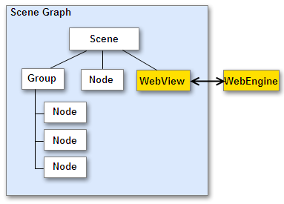
JavaFX GUI Components (2) • Sep. 27, 2021
Anchor Pane
WEB VIEW
CSS
Additional UI
EventHandler
GUI COMPONENTS (1)
IMAGE VIEW

Slide 16
JavaFX GUI Components (2) • Sep. 27, 2021
https://docs.oracle.com/javase/8/javafx/user-interface-tutorial
https://docs.oracle.com/javase/8/javafx/api/javafx
https://www.tutorialspoint.com/javafx
References

